Slide 1
Epi 510: Introduction to R III
Fall 2021
Jeff Stanaway, MPH PhD

Slide 2
Office hours
Thursdays @ 3-4pm https://washington.zoom.us/j/95422560196

Slide 3
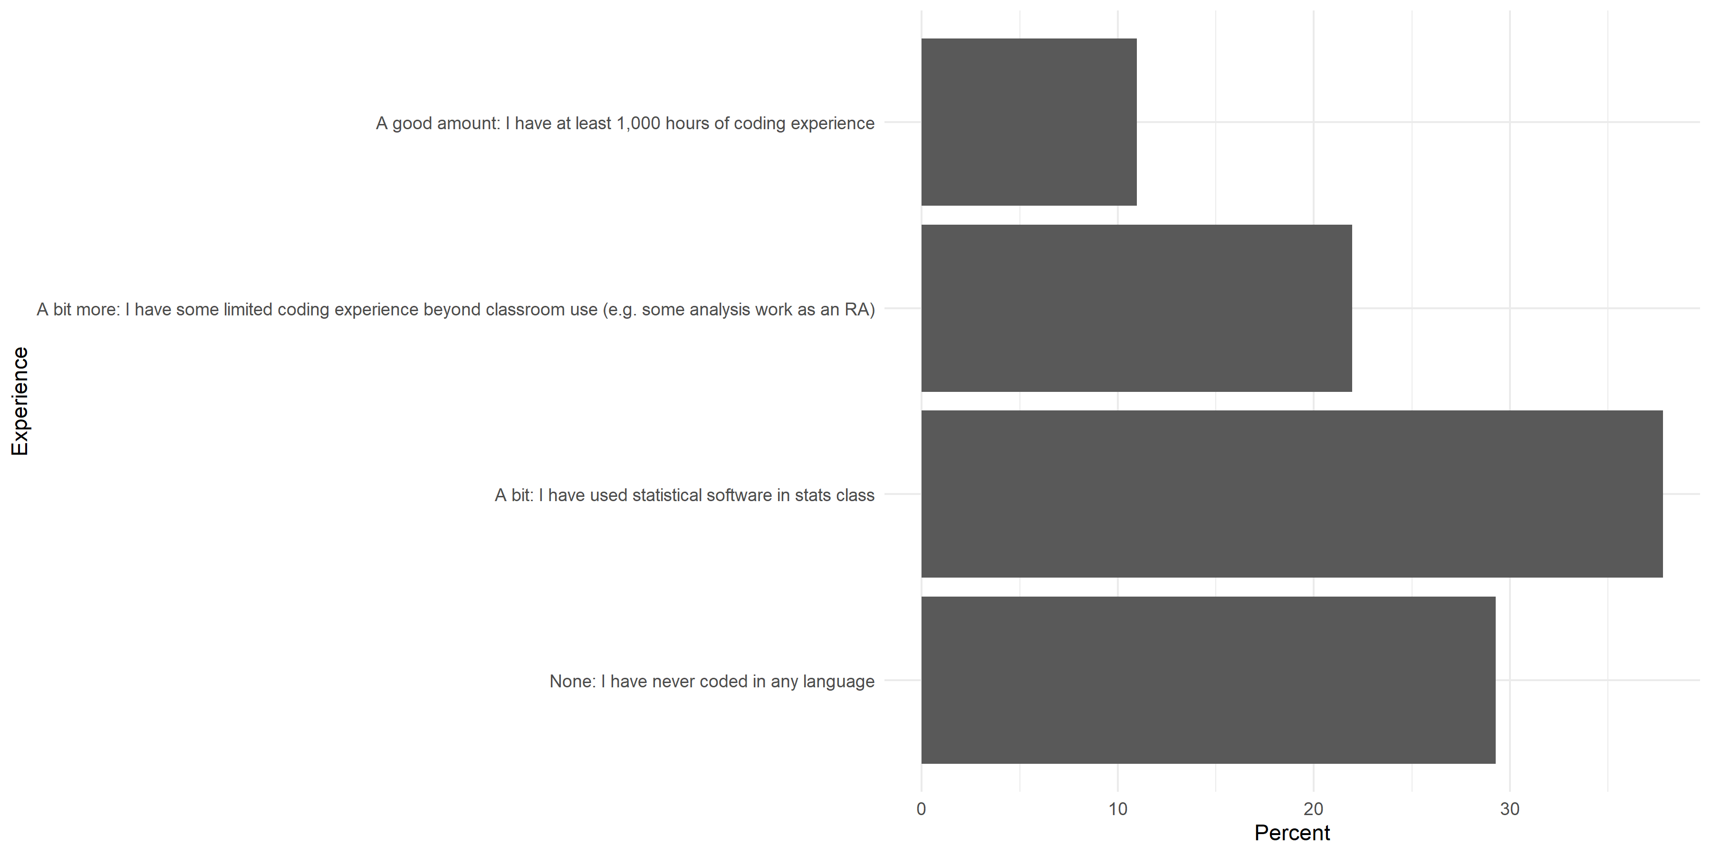

Slide 4
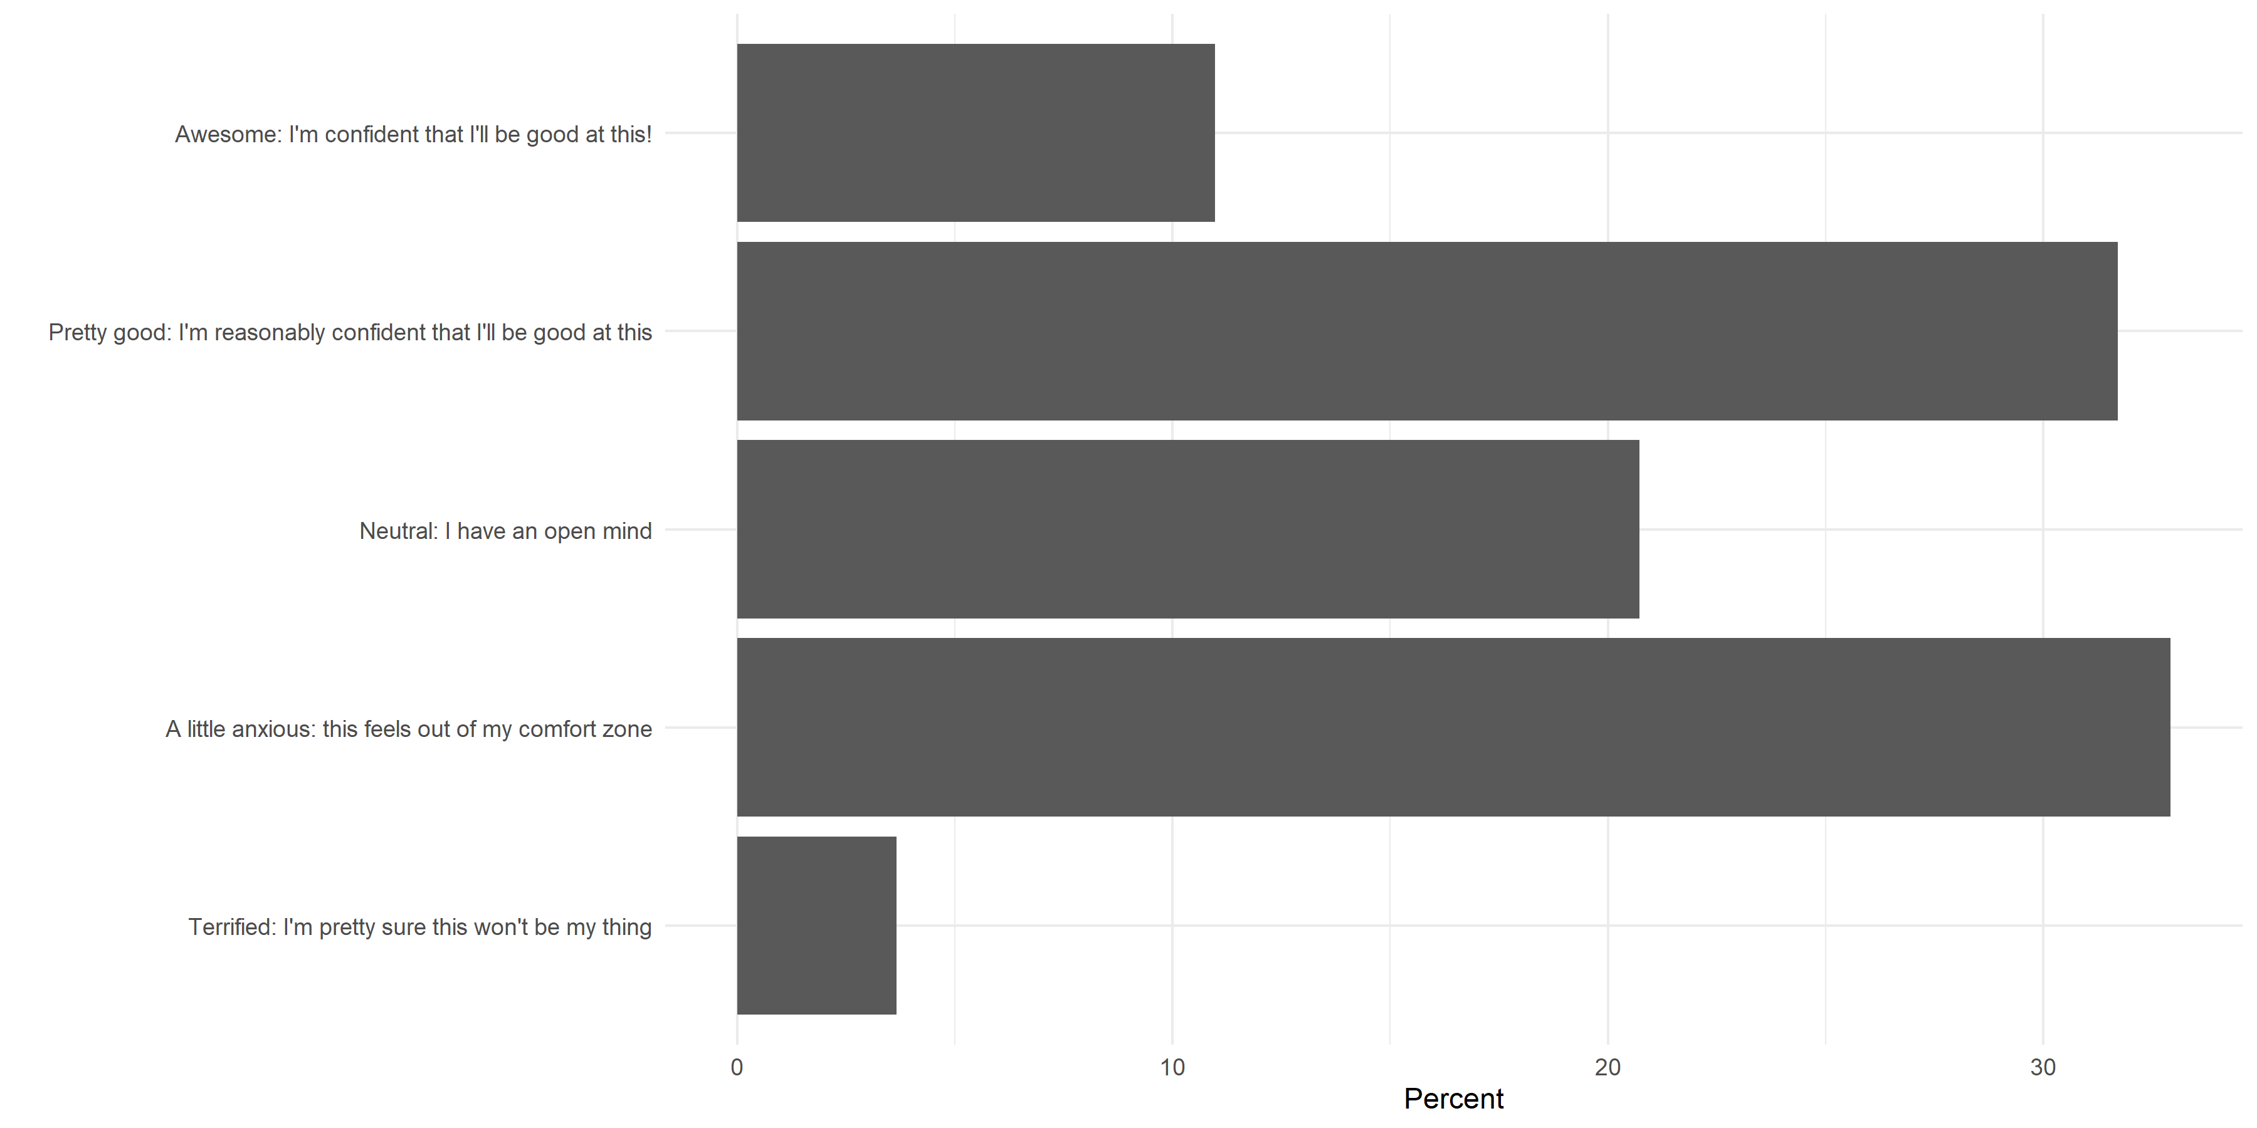

Slide 5
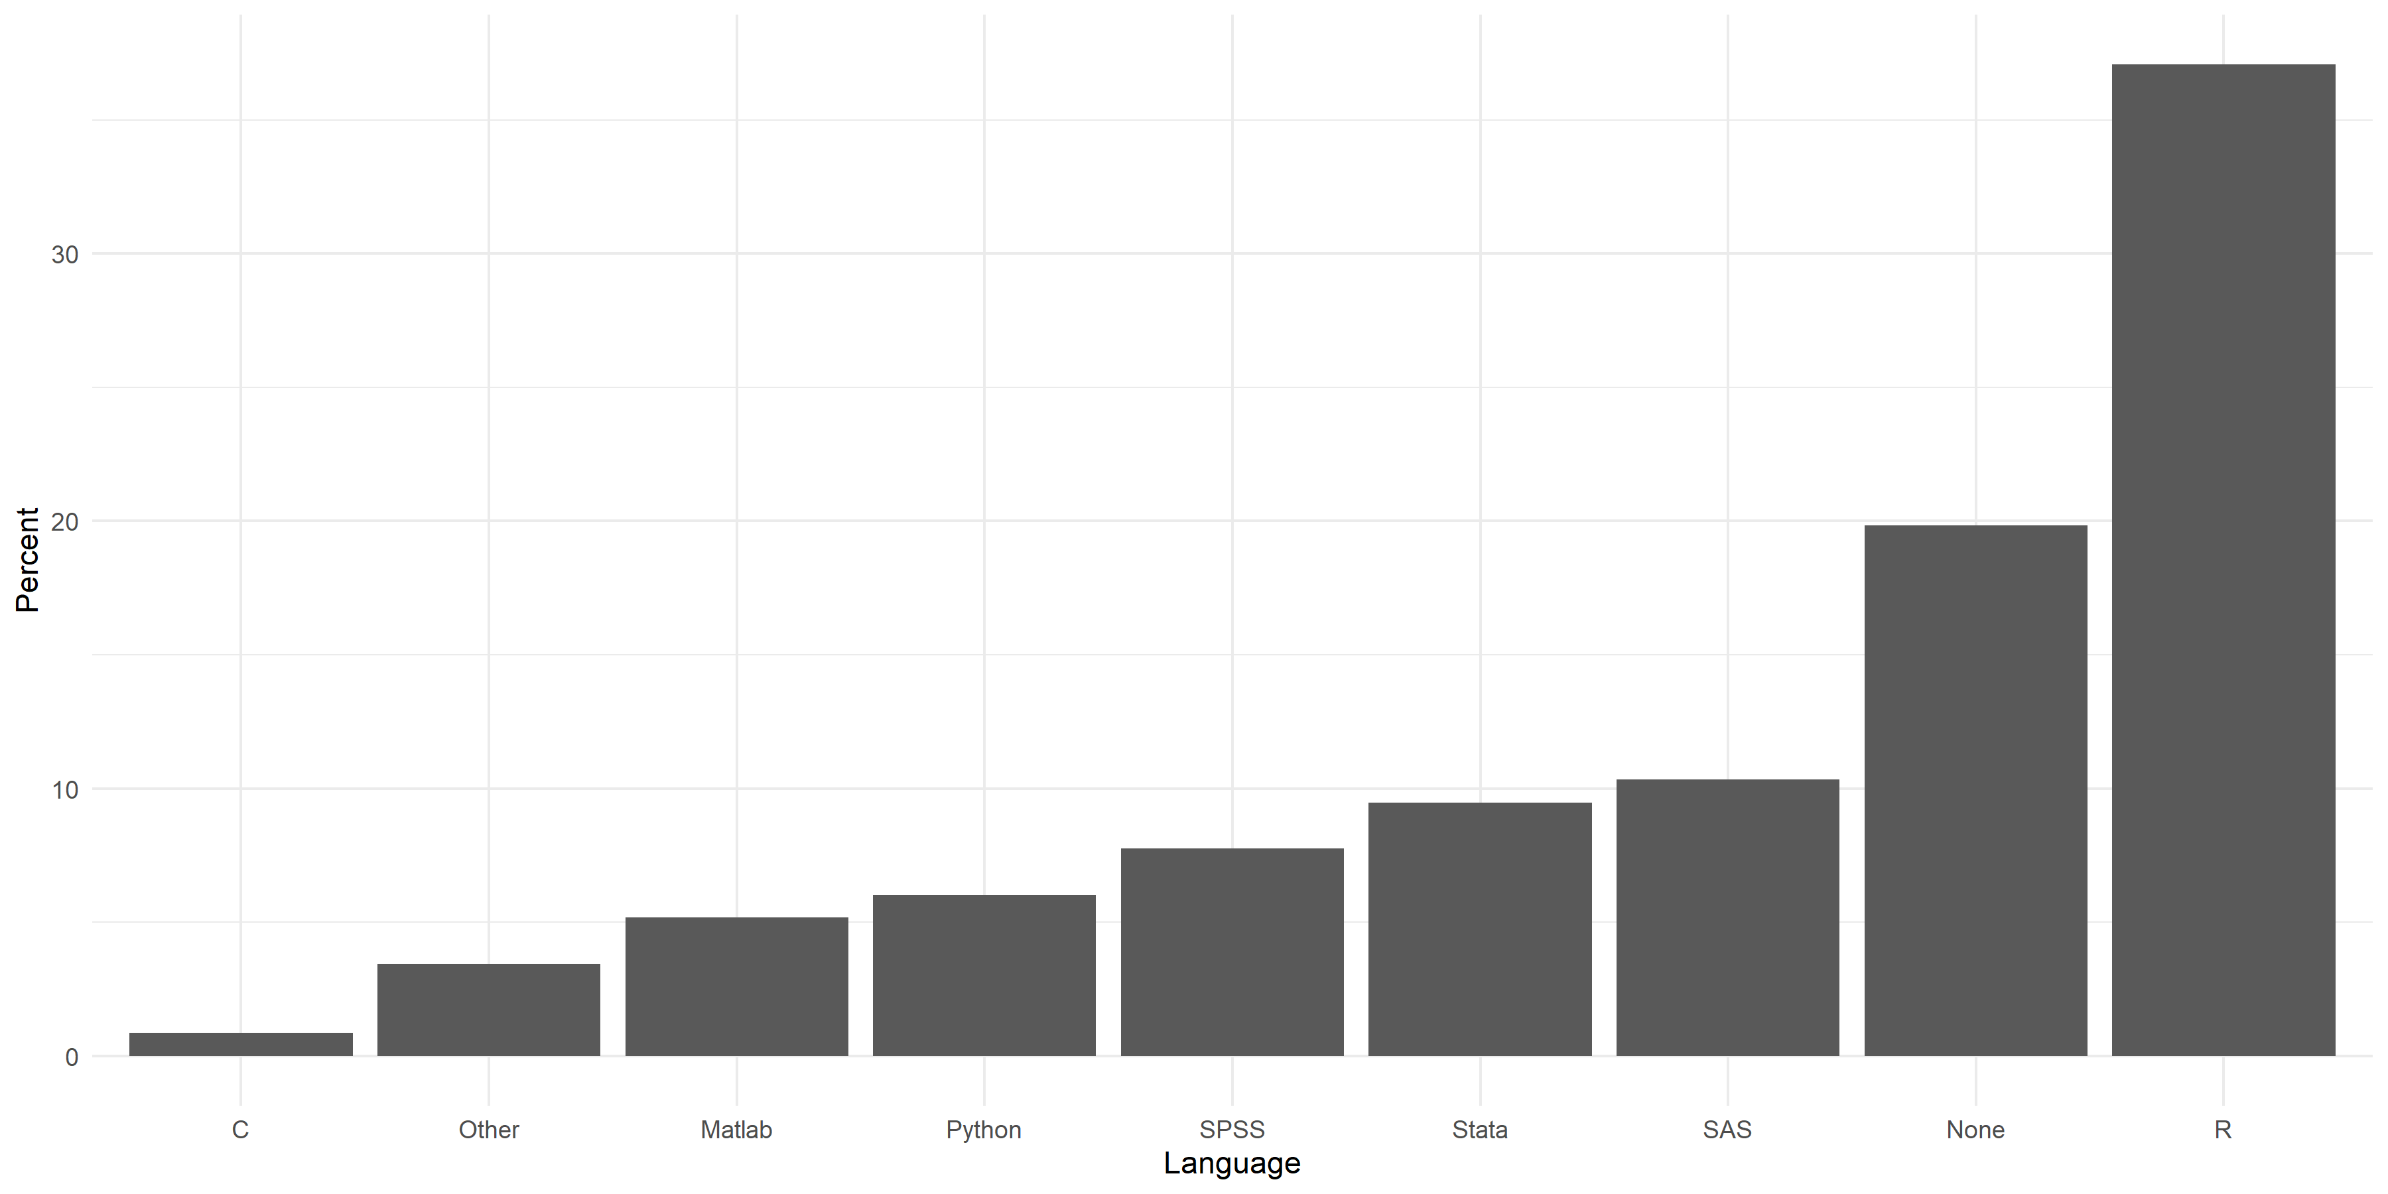

Slide 6
Data structures
Summary statistics & frequency tables
Basic data creation and modification
Reading & exploring the data
Getting started
Missing values and data types
Getting help
X
X
X
X

Slide 7
Let's load up the dataset
rm(list = ls())
setwd("C:/epi510/r/data")
vipcls <- read.csv("vipcls.csv", stringsAsFactors = F)
vipcls[vipcls==-1] <- NA

Slide 8
Summary statistics
R has many functions for calculating summary statistics:
Other useful commands: var(), median(), min(), max(), range(), sum(), table()
> mean(vipcls$momage)
[1] 24.31298
> sd(vipcls$momage)
[1] 5.536978
> quantile(vipcls$momage, c(0, 0.1, 0.25, 0.5, 0.75, 0.9, 1))
0% 10% 25% 50% 75% 90% 100% -1 18 20 23 28 32 46

Slide 9
Summary statistics
Let's deal with missing values
> vipcls[vipcls==-1] <- NA
> mean(vipcls$momage)
[1] NA
> sd(vipcls$momage)
[1] NA
> quantile(vipcls$momage, c(0, 0.1, 0.25, 0.5, 0.75, 0.9, 1))
Error in quantile.default(vipcls$momage[vipcls$pregnum == 1], c(0, 0.1, : missing values and NaN's not allowed if 'na.rm' is FALSE

Slide 10
Summary statistics
The default for most R functions is to retain missing values.
We need to override this default to get sensible results
> mean(vipcls$momage, na.rm = TRUE)
[1] 24.32061
> sd(vipcls$momage, na.rm = TRUE)
[1] 5.520354
> quantile(vipcls$momage, c(0, 0.1, 0.25, 0.5, 0.75, 0.9, 1) , na.rm = TRUE)
0% 10% 25% 50% 75% 90% 100% 15 18 20 23 28 32 46

Slide 11
Exercise
Find the mean and standard deviation of birthweight

Slide 12
Summary statistics
The summary() function is analogous to command summarize in Stata.
summary(vipcls)
Output includes the number of NAs, basic summary statistics for numeric variables, and frequency in each level for factors/logicals.

Slide 13
Summary() output
> summary(vipcls)
patid delmo deldy delyr enrmo
Min. :1200005 Min. : 1.000 Min. : 1.00 Min. :1984 Min. : 1.000
1st Qu.:5269709 1st Qu.: 3.000 1st Qu.: 8.00 1st Qu.:1986 1st Qu.: 3.000
Median :7076300 Median : 6.000 Median :16.00 Median :1987 Median : 7.000
Mean :6380925 Mean : 6.458 Mean :15.67 Mean :1987 Mean : 6.452
3rd Qu.:7578503 3rd Qu.: 9.000 3rd Qu.:23.00 3rd Qu.:1988 3rd Qu.: 9.000
Max. :9500406 Max. :12.000 Max. :31.00 Max. :1989 Max. :12.000
NA's :610 NA's :610 NA's :610 NA's :20
enrdy enryr momage raceth grade
Min. : 1.00 Min. :1984 Min. :15.00 Min. :0.000 Min. : 0.00
1st Qu.: 8.00 1st Qu.:1985 1st Qu.:20.00 1st Qu.:0.000 1st Qu.:10.00
Median :15.00 Median :1986 Median :23.00 Median :1.000 Median :12.00
Mean :15.51 Mean :1986 Mean :24.32 Mean :1.062 Mean :11.52
3rd Qu.:23.00 3rd Qu.:1987 3rd Qu.:28.00 3rd Qu.:2.000 3rd Qu.:12.00
Max. :31.00 Max. :1989 Max. :46.00 Max. :2.000 Max. :27.00
NA's :20 NA's :20 NA's :4 NA's :30
marstat cigs1 cigs2 etoh1 etoh2
Min. :1.000 Min. : 0 Min. : 0.00 Min. :1.00 Min. :1.000
1st Qu.:1.000 1st Qu.: 0 1st Qu.: 0.00 1st Qu.:6.00 1st Qu.:6.000
Median :2.000 Median : 0 Median : 0.00 Median :6.00 Median :6.000
Mean :2.883 Mean : 4 Mean : 3.07 Mean :5.57 Mean :5.674
3rd Qu.:5.000 3rd Qu.: 3 3rd Qu.: 2.00 3rd Qu.:6.00 3rd Qu.:6.000
Max. :5.000 Max. :92 Max. :70.00 Max. :6.00 Max. :6.000
NA's :12 NA's :1 NA's :1 NA's :2 NA's :3
partyr pregnum delges bw deltype
Min. : 0.00 Min. : 1.000 Min. :23.00 Min. : 143 Min. :1.000
1st Qu.: 1.00 1st Qu.: 1.000 1st Qu.:38.00 1st Qu.:2956 1st Qu.:1.000
Median : 1.00 Median : 2.000 Median :39.00 Median :3295 Median :1.000
Mean : 1.26 Mean : 2.642 Mean :39.07 Mean :3268 Mean :1.208
3rd Qu.: 1.00 3rd Qu.: 3.000 3rd Qu.:41.00 3rd Qu.:3630 3rd Qu.:1.000
Max. :200.00 Max. :16.000 Max. :70.00 Max. :6549 Max. :2.000
NA's :223 NA's :473 NA's :649
induclab auglab intrapih
Min. :1.000 Min. :1.000 Min. :1.000
1st Qu.:2.000 1st Qu.:1.000 1st Qu.:2.000
Median :2.000 Median :2.000 Median :2.000
Mean :1.909 Mean :1.649 Mean :1.929
3rd Qu.:2.000 3rd Qu.:2.000 3rd Qu.:2.000
Max. :2.000 Max. :2.000 Max. :2.000
NA's :465 NA's :462 NA's :338

Slide 14
Summary() output
> summary(vipcls$momage)
Min. 1st Qu. Median Mean 3rd Qu. Max. NA's 15.00 20.00 23.00 24.32 28.00 46.00 4

Slide 15
Exercise
Summarize birthweight

Slide 16
Frequency tables
To create a one-way or two-way freqency table, use the table() function. Use optional argument, deparse.level=2, to print the variable names with the table.

Slide 17
Frequency tables
Note that NAs are excluded from the table. Another optional argument, useNA=“ifany” or useNA=“always”, will include NAs in the table.

Slide 18
Proportion tables
Unfortunately, the table() function does not offer options for calculating proportions. For this, we can use prop.table(). By default, cell proportions are produced.

Slide 19
Proportion tables
If you would prefer to see percentages, you can accomplish this by multiplying the table by 100.

Slide 20
Proportion tables
To get row percentages, use margin=1.
prop.table(tableA, margin=1)*100 #row percents
##
## FALSE TRUE
## white 87.3 12.7
## hispanic 88.7 11.3
## black 87.4 12.6

Slide 21
Proportion tables
To get column percentages, use margin=2.
prop.table(tableA, margin=2)*100 #column percents
##
## FALSE TRUE
## white 31.6 33.0
## hispanic 30.6 28.1
## black 37.8 39.0

Slide 22
Data structures
Summary statistics & frequency tables
Basic data creation and modification
Reading & exploring the data
Getting started
Missing values and data types
Getting help
X
X
X
X
X

Slide 23
Indexing
An index is direction to R to only use specific elements of an object. Indexing is the primary way to create a subset in base R.
vipcls$momage[1:10]
## [1] 24 26 22 26 21 25 20 35 20 29
vipcls$momage[3:7]
## [1] 22 26 21 25 20

Slide 24
Indexing
We can also provide R with an index for a data frame. We need to tell R both which rows and which columns we are interested in. Note that the row index comes before the comma and the column index comes after the comma.
vipcls[1, 9:16]
## raceth grade marstat cigs1 cigs2 etoh1 etoh2 partyr
## 1 1 13 1 0 0 6 6 1

Slide 25
Indexing
We can also ask for all of one dimension, for example, all columns for a partcular row. We do this by leaving the column specification blank.
vipcls[1, ]
## patid delmo deldy delyr enrmo enrdy enryr momage raceth grade marstat
## 1 1200005 -1 -1 -1 4 27 1987 24 1 13 1
## cigs1 cigs2 etoh1 etoh2 partyr pregnum delges bw deltype induclab
## 1 0 0 6 6 1 2 40 2650 1 2
## auglab intrapih
## 1 2 2
Alternately, we could specify all rows of a column leaving the row specification blank.
vipcls[ , 8]
## [1] 24 26 22 26 21 25 20 35 20 29 24 21 28 21 23 29 25 27 29 24
## [ reached getOption("max.print") -- omitted 13265 entries ]

Slide 26
Conditional subsetting
We’ll now look at how to use indexing to create conditional subsets. Ultimately, we can use this way of indexing to subset data based on one or more conditions. Subsets can be assigned to a new object. . .
vipcls2 <- vipcls[vipcls$raceth=="hispanic",]
or conditionally recoded
vipcls$momage[vipcls$momage==15] <- NA

Slide 27
Conditional subsetting
Summary stats for maternal age among first-time mothers?
> mean(vipcls$momage[vipcls$pregnum==1], na.rm = TRUE)
[1] 20.81749
> sd(vipcls$momage[vipcls$pregnum==1], na.rm = TRUE)
[1] 4.027764
> quantile(vipcls$momage[vipcls$pregnum==1], c(0, 0.1, 0.25, 0.5, 0.75, 0.9, 1) , na.rm = TRUE)
0% 10% 25% 50% 75% 90% 100% 15 17 18 20 23 26 46

Slide 28
Exercise
What are the values of patid in rows 5 through 10?

Slide 29
Logical expressions
Logical expressions are code segments that instruct R to check whether a statement is true and return a logical value (TRUE or FALSE). Like Stata, testing equality in R is done with the special operator, ==, as follows.
vipcls$patid[1]==1200005
## [1] TRUE
Other logical operators are:
>, >=, <, <=, !, &, |

Slide 30
Creating columns
Create new columns using assignment operator:
> vipcls$bwLbs <- vipcls$bw / 453.592
> vipcls$index <- 1:nrow(vipcls)
> head(vipcls, n=10)
patid delmo deldy delyr enrmo enrdy enryr momage raceth grade marstat cigs1 cigs2 etoh1 etoh2 partyr pregnum delges bw deltype induclab auglab intrapih bwLbs index
1 1200005 NA NA NA 4 27 1987 24 1 13 1 0 0 6 6 1 2 40 2650 1 2 2 2 5.842255 1
2 1200104 11 9 1987 5 13 1987 26 2 11 5 0 0 4 4 1 4 40 2725 1 2 2 2 6.007602 2
3 1200203 10 31 1987 3 31 1987 22 2 12 5 0 0 6 6 1 2 39 3232 1 2 2 2 7.125346 3
4 1200302 11 3 1987 7 1 1987 26 1 16 3 0 0 6 6 1 2 38 3195 1 2 2 2 7.043775 4
5 1200401 11 3 1987 6 2 1987 21 2 12 5 0 0 6 6 1 1 38 2720 1 1 2 1 5.996578 5
6 1200500 11 1 1987 4 3 1987 25 1 12 5 0 0 6 6 1 3 38 3629 1 2 1 2 8.000582 6
7 1200609 10 24 1987 5 8 1987 20 2 11 5 3 3 6 6 1 2 37 2090 1 2 2 2 4.607665 7
8 1200708 NA NA NA 4 10 1987 35 1 8 3 0 0 6 6 1 8 37 3015 1 2 2 2 6.646943 8
9 1200807 10 4 1987 3 18 1987 20 1 12 1 0 0 6 6 1 1 38 3430 1 2 1 2 7.561862 9
10 1201003 10 2 1987 3 23 1987 29 1 12 2 0 0 6 6 1 4 40 3686 1 2 2 2 8.126246 10

Slide 31
Modifying columns
Similarly, modify columns using assignment operator:
> summary(vipcls$delges)
Min. 1st Qu. Median Mean 3rd Qu. Max.
23.00 38.00 39.00 39.07 41.00 70.00
> vipcls$delges[vipcls$delges > 53] <- 53
> summary(vipcls$delges)
Min. 1st Qu. Median Mean 3rd Qu. Max.
23.00 38.00 39.00 39.07 41.00 53.00

Slide 32
Modifying columns: missing values
Replace values that correspond to missing with NAs
> summary(vipcls$delmo)
Min. 1st Qu. Median Mean 3rd Qu. Max.
-1.000 3.000 6.000 6.116 9.000 12.000
> vipcls$delmo[vipcls$delmo==-1] <- NA
> summary(vipcls$delmo)
Min. 1st Qu. Median Mean 3rd Qu. Max. NA's
1.000 3.000 6.000 6.458 9.000 12.000 610
To recode a value across the entire dataframe, use the following syntax.
vipcls[vipcls==-1] <- NA # Works for numeric variables
vipcls[vipcls=="-1"] <- NA # Works for character or factor variables

Slide 33
Exercise
Set mother’s age (momage) of 15 or less to missing (i.e. to NA)

Slide 34
Recoding binary variables to logicals
Now we know enough to convert a binary variable found in vipcls to a more useful coding scheme.
vipcls$induclab[vipcls$induclab==2] <- 0 # change 2's to 0's
vipcls$induclab <- as.logical(vipcls$induclab) # convert to logical

Slide 35
Putting things together to recode factors in vipcls
We can also recode multi-level categorical variables, like etoh2, to be more intuitive and useful for our subsequent analyses.
vipcls$etoh2 <- factor(vipcls$etoh2,
levels = 1:6,
labels=c("every day", "3-5/wk", "1/wk","<1/wk", "<1/month", "never")) # convert to factor
levels(vipcls$etoh2) # check levels
## [1] "every day" "3-5/wk" "1/wk" "<1/wk" "<1/month" "never"

Slide 36
Creating categorical variables
Let's create a maternal age category variable
vipcls$momage[vipcls$momage<=15] <- NA
vipcls$momAgeCat[vipcls$momage<=19] <- 1
vipcls$momAgeCat[vipcls$momage>19 & vipcls$momage<30] <- 2
vipcls$momAgeCat[vipcls$momage>=30] <- 3

Slide 37
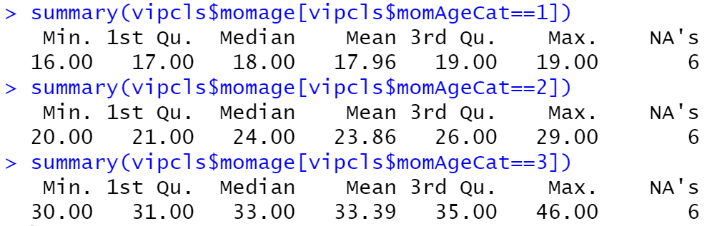
Creating categorical variables
Let's check the contents

Slide 38
Converting to a labelled factor variable
Let's create a maternal age category variable
vipcls$momAgeCat <- factor(vipcls$momAgeCat, levels = 1:3, labels = c("<20 years", "20-29 years", "30+ years"))
table(vipcls$momAgeCat, useNA = "always")
<20 years 20-29 years 30+ years <NA>
2875 7974 2430 6

Slide 39
Exercise
Create a maternal age category in which you categorize maternal age in 5-year bins (i.e. <20, 20-24, 25-29, 30-34, 35+). Convert this to a labelled factor variable.

Slide 40
Removing columns
You can remove a single column by assigning it to NULL:
You can alternatively code as
> names(vipcls)
[1] "patid" "delmo" "deldy" "delyr" "enrmo" "enrdy" "enryr" "momage" "raceth" "grade" "marstat" "cigs1"
[13] "cigs2" "etoh1" "etoh2" "partyr" "pregnum" "delges" "bw" "deltype" "induclab" "auglab" "intrapih"
> vipcls$patid <- NULL
> names(vipcls)
[1] "delmo" "deldy" "delyr" "enrmo" "enrdy" "enryr" "momage" "raceth" "grade" "marstat" "cigs1" "cigs2"
[13] "etoh1" "etoh2" "partyr" "pregnum" "delges" "bw" "deltype" "induclab" "auglab" "intrapih"
> vipcls[,"patid"] <- NULL
> names(vipcls)
[1] "delmo" "deldy" "delyr" "enrmo" "enrdy" "enryr" "momage" "raceth" "grade" "marstat" "cigs1" "cigs2"
[13] "etoh1" "etoh2" "partyr" "pregnum" "delges" "bw" "deltype" "induclab" "auglab" "intrapih"

Slide 41
Removing columns
This also allows us to remove multiple columns at once:
> names(vipcls)
[1] "patid" "delmo" "deldy" "delyr" "enrmo" "enrdy" "enryr" "momage" "raceth" "grade" "marstat" "cigs1"
[13] "cigs2" "etoh1" "etoh2" "partyr" "pregnum" "delges" "bw" "deltype" "induclab" "auglab" "intrapih"
> vipcls[,c("patid", "delmo", "deldy", "delyr")] <- NULL
> names(vipcls)
[1] "enrmo" "enrdy" "enryr" "momage" "raceth" "grade" "marstat" "cigs1" "cigs2" "etoh1" "etoh2"
[12] "partyr" "pregnum" "delges" "bw" "deltype" "induclab" "auglab" "intrapih"

Slide 42
Keeping columns
We can flip what we just did to keep selected columns:
> vipcls <- vipcls[, c("enrmo", "enrdy", "enryr", "momage", "raceth", "grade", "marstat")]
> names(vipcls)
[1] "enrmo" "enrdy" "enryr" "momage" "raceth" "grade" "marstat"

Slide 43
Sorting: order()
The order() function gives you the indices of a vector according to the rank
order of the values of that vector:

Slide 44
Sorting: order()
We can use this to sort rows of a data frame by index:

Slide 45
Sorting: order()
Can also be used to sort multiple variables

Slide 46
Data structures
Summary statistics & frequency tables
Basic data creation and modification
Reading & exploring the data
Getting started
Missing values and data types
Getting help
X
X
X
X
X
X

Slide 47
Built-in help files
Documentation for R functions can be accessed from R and RStudio using the ? operator (e.g. ?names).
Help Section Describes
Description Usage Arguments Details Value Examples
What the function does
Syntax for how to call the function
Options for controlling function behavior More detail on function behavior
What the function returns
Working code using the function

Slide 48
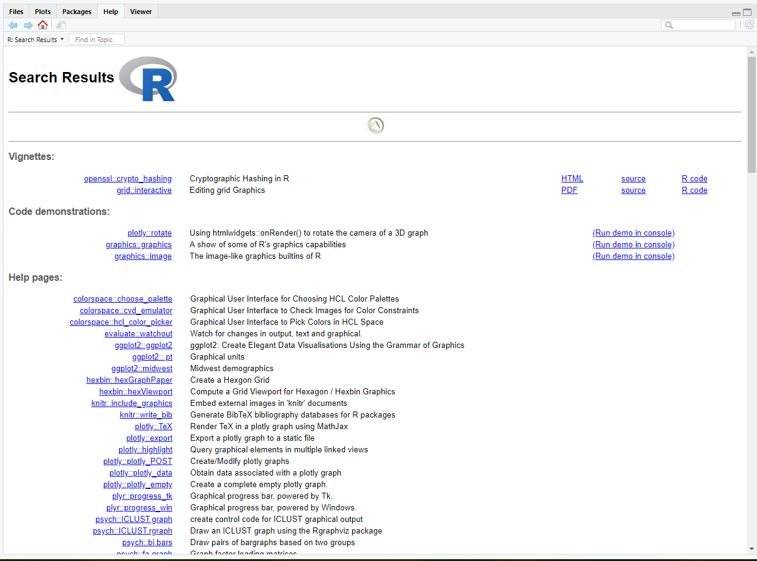
Built-in help files
Search documentation when you don't know the function name with ??
??graph

Slide 49
CRAN
Comprehensive R Archive Network (CRAN) is a network of servers around the world that store identical, up-to-date, versions of code and documentation for R.
Accessing CRAN:
Go to website and search for package.
Search the internet for package name and “CRAN”(e.g. “ggplot2 CRAN”).
https://cran.r-project.org/

Slide 50
Webpages and forums
When will help files not be helpful?
You don’t not know the name of the function that you need
Function help file is confusing or doesn’t seem to explain your problem
You’re looking for a new package
What now? Try searching the internet for:
what you are trying to do (e.g. “conditionally select rows in R”)
quote the text of an error (e.g. “Error in sum(”a“,”a“) : invalid ‘type’ (character) of argument”)

Slide 51
Webpages and forums
This will often bring you to:
R instructional pages (like Quick-R)
Programming forums such as StackExchange and StackOverflow
Important culture note: Before posting a question on these forums, read and understand the community guidelines! Posts asking for answers to homework problems are widely frowned upon and may violate academic integrity rules.

Slide 52
More information on help
More places to look for help: https://www.r-project.org/help.html
https://support.rstudio.com/hc/en-us/articles/200552336-Getting-Help-with-R https://support.rstudio.com/hc/en-us

Slide 53
Data structures
Summary statistics & frequency tables
Basic data creation and modification
Reading & exploring the data
Getting started
Missing values and data types
Getting help
X
X
X
X
X
X
X

Slide 54
Math, date, & string functions

Slide 55
Math functions
abs(x) Absolute value of x
exp(x) e^{x}
log(x) natural log of x
log(x, base) base-base log of x
sqrt(x) square-root of x
x%%y modulus of x with respect to y
factorial(x) factorial of x (x!)
help functions

Slide 56
Math functions: rounding
ceiling(x) x rounded up
floor(x) x rounded down
trunc(x) x rounded toward 0
round(x) x rounded to nearest integer
round(x,y) x rounded with y digits after the decimal
help functions

Slide 57
Pattern matching
R has several functions for matching patterns in character vectors, including grepl(), which returns a logical vector telling you where there are matches:
and grep(), which return the indices of any matches:
or, the actual matches, if value = TRUE:
states <- c("North Carolina", "North Dakota", "South Dakota")
grepl("Dakota", states)
[1] FALSE TRUE TRUE
grep("Dakota", states)
[1] 2 3
> grep("Dakota", states, value = TRUE)
[1] "North Dakota" "South Dakota"

Slide 58
Exercise
Use grep to find all variable names that contain "del"
Use the above grep function nested in a summary function to summarize all variables with names that contain "del"

Slide 59
Other string functions
Many (MANY!!!) more string functions are available:
tolower(states) # convert all strings to lower case
[1] "north carolina" "north dakota" "south dakota"
toupper(states) # convert all strings to upper case
[1] "NORTH CAROLINA" "NORTH DAKOTA" "SOUTH DAKOTA"
substr(states, 1, 5) # return the first 5 characters of each string
[1] "North" "North" "South"
nchar(states) # return the number of characters in each string
[1] 14 12 12

Slide 60
Pasting
paste and paste0 concatenate strings or objects
paste allows you to choose the separator (default is a space)
paste0 places no separator between objects

Slide 61
Paste
Let’s look at paste more closely:
> day <- 19:21
> month <- "September"
> year <- 2017
>
> paste0(month, day, year)
[1] "September192017" "September202017" "September212017"
> paste(month, day, year)
[1] "September 19 2017" "September 20 2017" "September 21 2017"
> paste(month, day, year, sep = "-")
[1] "September-19-2017" "September-20-2017" "September-21-2017"

Slide 62
Pasting file paths
We've used setwd() to avoid retyping full paths
Another alternative is to use paste:
dataDir <- "C:/epi510/r/data/"
vipcls <- read.csv(paste0(dataDir,"vipcls.csv"))

Slide 63
Dates
Usually advantageous to store dates and date components as a Date type variable
Make using as.Date("YYYY-MM-DD")
Converts to numeric value of number of days from January 1st 1970, labelled in HRF
as.numeric(as.Date("1970-01-01"))
[1] 0
as.numeric(as.Date("1971-01-01"))
[1] 365

Slide 64
Dates
Let’s make a date variables for delivery
vipcls$delDate <-as.Date(paste(vipcls$delyr, vipcls$delmo, vipcls$deldy, sep='-'))
Error in charToDate(x) :
character string is not in a standard unambiguous format
# Let's look at first few observations of the del date variables to investigate
head(vipcls[,grep("del", names(vipcls))])
delmo deldy delyr delges deltype
1 NA NA NA 40 1
2 11 9 1987 40 1
3 10 31 1987 39 1
4 11 3 1987 38 1
5 11 3 1987 38 1
6 11 1 1987 38 1

Slide 65
Dates
We have a couple of options to deal with this:
We can sort the data by the del date variables, so NAs won't be in the first row
sortExample <- vipcls[order(vipcls$delmo),]
head(sortExample[,grep("del", names(sortExample))])
delmo deldy delyr delges deltype
51 1 6 1988 41 2
71 1 8 1988 40 1
82 1 1 1988 42 1
84 1 31 1988 38 1
88 1 8 1988 39 1
96 1 6 1988 36 1
sortExample$delDate <- as.Date(
paste(sortExample$delyr, sortExample$delmo, sortExample$deldy, sep='-'))

Slide 66
Dates
We have a couple of options to deal with this:
We can sort the data by the del date variables, so NAs won't be in the first row
We can first paste the date components, recode NAs, and then convert to date format
# a) paste components and look at result
vipcls$delDate <- paste(vipcls$delyr, vipcls$delmo, vipcls$deldy, sep='-')
head(vipcls$delDate)
[1] "NA-NA-NA" "1987-11-9" "1987-10-31" "1987-11-3" "1987-11-3" "1987-11-1"
# b) recode NAs and take a look
vipcls$delDate[grep("NA", vipcls$delDate)] <- NA
head(vipcls$delDate)
[1] NA "1987-11-9" "1987-10-31" "1987-11-3" "1987-11-3" "1987-11-1"
#c) convert to date format
vipcls$delDate <-as.Date(vipcls$delDate)

Slide 67
Dates
summary(vipcls$delDate)
Min. 1st Qu. Median Mean 3rd Qu. Max. NA's
"1984-11-18" "1986-03-03" "1987-02-17" "1987-03-29" "1988-04-07" "1989-09-05" "610"
summary(as.numeric(vipcls$delDate))
Min. 1st Qu. Median Mean 3rd Qu. Max. NA's
5435 5905 6256 6296 6671 7187 610

Slide 68
Exercise
Create a date variable for enrollment
Enrollment year = vipcls$enryr
Enrollment month = vipcls$enrmo
Enrollment day = vipcls$enrdy

Slide 69
Dates
What if we want to know the number of days between enrollment and delivery? Use difftime()
enrToDelDays <- difftime(vipcls$delDate,vipcls$enrDate)
summary(enrToDelDays)
Length Class Mode
13285 difftime numeric
summary(as.numeric(enrToDelDays))
Min. 1st Qu. Median Mean 3rd Qu. Max. NA's
-18.0 135.0 169.0 165.8 198.0 549.0 628
enrToDelWeeks <- difftime(vipcls$delDate,vipcls$enrDate, units="weeks")
summary(enrToDelWeeks)
Length Class Mode
13285 difftime numeric
summary(as.numeric(enrToDelWeeks))
Min. 1st Qu. Median Mean 3rd Qu. Max. NA's
-2.571 19.286 24.143 23.689 28.286 78.429 628

Slide 70
Dates
We can extract date components using the format() function:
table(format(vipcls$delDate, "%Y"))
1984 1985 1986 1987 1988 1989
9 2609 3297 2737 2730 1293
table(format(vipcls$delDate, "%m"))
01 02 03 04 05 06 07 08 09 10 11 12
1074 1098 1090 878 1117 1171 1171 1022 904 1049 1019 1082
table(format(vipcls$delDate, "%B"))
April August December February January July June March
878 1022 1082 1098 1074 1171 1171 1090
May November October September
1117 1019 1049 904
table(format(vipcls$delDate, "%d"))
01 02 03 04 05 06 07 08 09 10 11 12 13 14 15 16 17 18 19 20
459 437 408 396 424 405 434 435 424 388 424 413 397 436 422 362 427 405 408 411
21 22 23 24 25 26 27 28 29 30 31
407 422 408 407 463 440 414 390 400 372 237

